Slide 1

BARCELONA AIRBNB LISTINGS ANALYSIS

Slide 2
PROJECT OVERVIEW
The growing number of vacation rentals in Barcelona has resulted in a significant rise in the cost of buying and renting a home.
In addition to the issue of housing availability, placing tourists in residential buildings can occasionally result in noise complaints, the degradation of communal espaces, and an increased sense of unease. Also the city's infrastructure can also be overloaded.
Given that Airbnb is the primary platform for facilitating vacation rentals, Barcelona City Council is in need of a thorough analysis of the properties listed in the platform in order to examine the distribution of this kind of properties in each neighbourhood, its features, user experiences, prices, and any other aspect to understand how this market operates.
The final goal will be to determine if it is necessary to establish certain restrictions on this type of rentals in order to develop a more sustainable tourism strategy.

Slide 3
PROJECT OVERVIEW
DATASET:
Contains all the listed properties Barcelona from 2008 to 2019 attending at their different characteristics and precise location. It also provides other information regarding the host scores,response, and availability. (19k rows x 100 col.)
PROJECT OBJECTIVE:
Based on the data provided the main focus is to understand the number of listings per area and the evolution along the years. Also the price variations depending on the neighbourhood, and other attributes.
ROADMAPPING
Navigating through the data set and understanding the information provided.
Data processing - Cleaning and restructuring key data. Adding columns to group information and ease analysis.
Exploratory data analysis supported by data visualization.
Data insights and conclusions.
I

Slide 4
DATA WRANGLING AND CLEANING
Loads of categorical values. / Date formatting / Filling Nan values / Creating New columns / Re-grouping
USE OF : Numpy, Pandas, Matplotly, Seaborn
Special feature - Plotly: density interactive map and a price interactive map.
Challenges :
Time management and having a proper understanding from the beginning of the information that was relevant for the analysis.
I

Slide 5
Exploratory data analysis

Slide 6

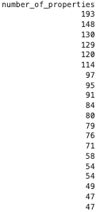
LISTINGS ANALYSIS
56% properties are instant bookable
20% hosts are super hosts
10% of the total amount
of listings
belong to the top 20 hosts.
50% hosts identity
has been verified
average rating 9.1

Slide 7
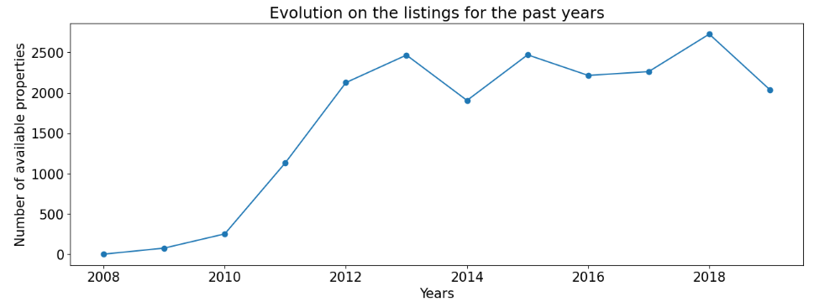
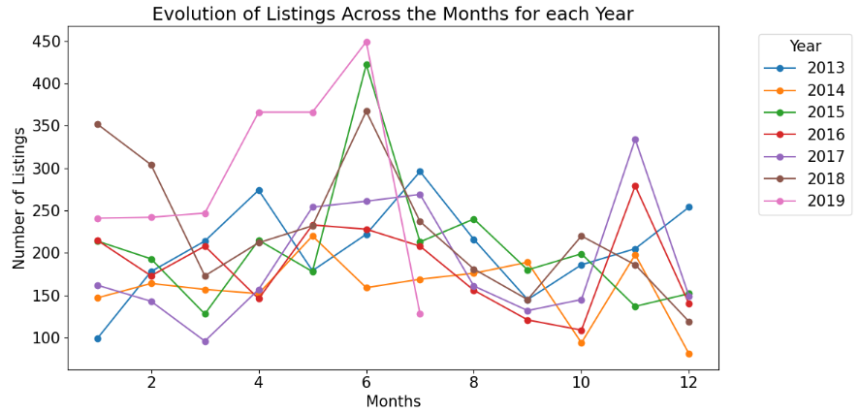
LISTINGS ANALYSIS
BY YEAR
NUMBER OF LISTINGS SPIKED AFTER 2012
2010 : 77
2019 : 19.600
BY MONTH
SEASONALITY IS A KEY FACTOR

Slide 8
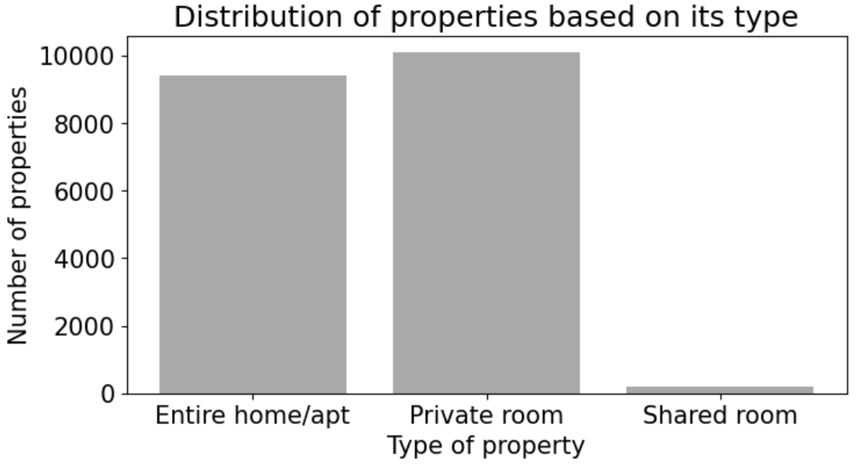
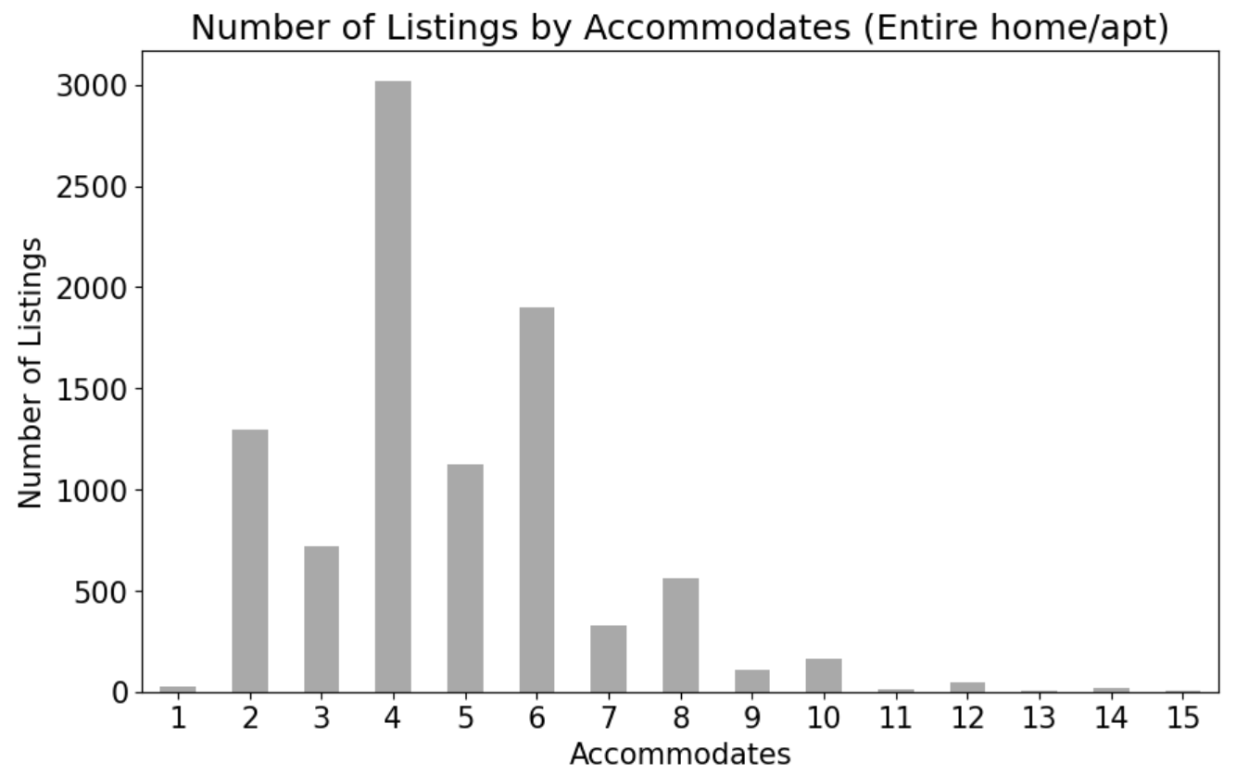
TYPES OF PROPERTIES

Slide 9
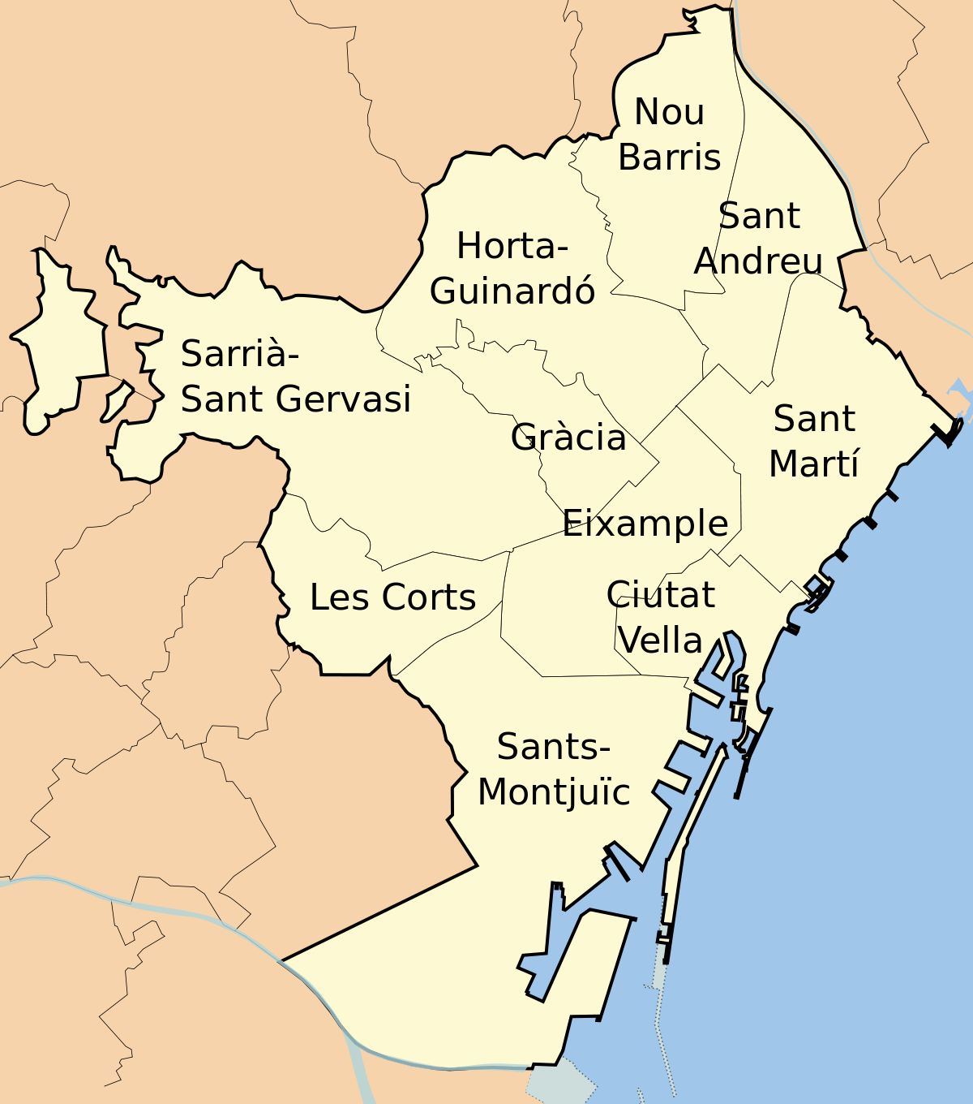
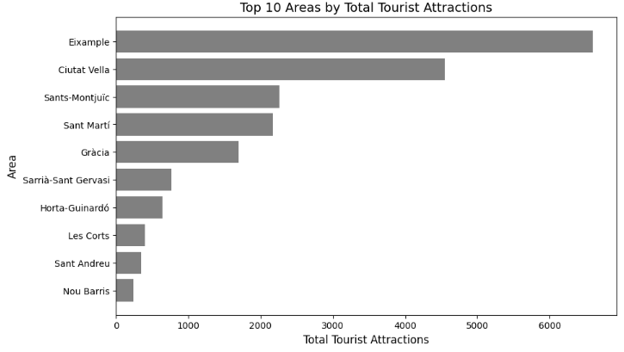
PRICES & AREAS ANALYSIS

Slide 10
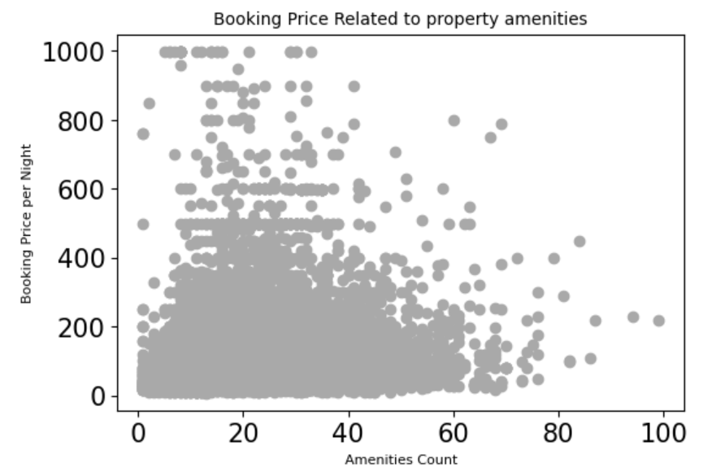
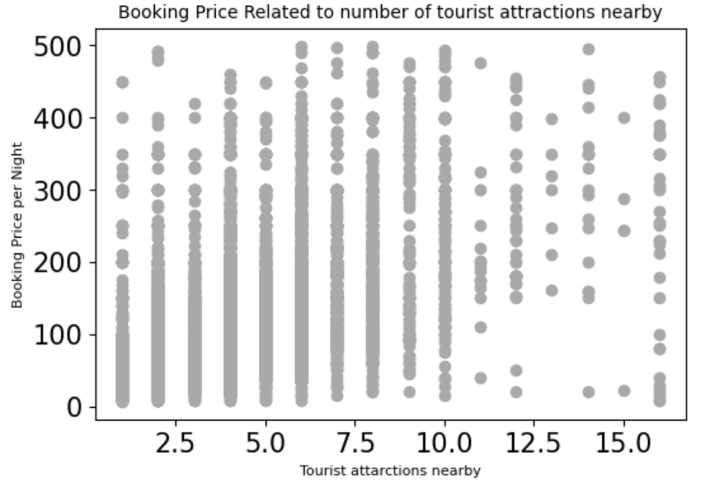
PRICES & AREAS ANALYSIS
How different attributes correlate to the price
**Graph shows price up to 1000€ and 500€ just to avoid outliers.

Slide 11
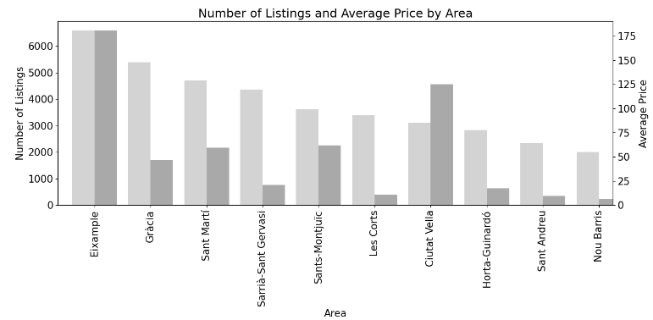


181€
148€
129€
120€
100€
93€
85€
78€
74€
65€
34%
9%
11%
4%
11%
2%
23%
3%
2%
1%
19.7K
105€

Slide 12
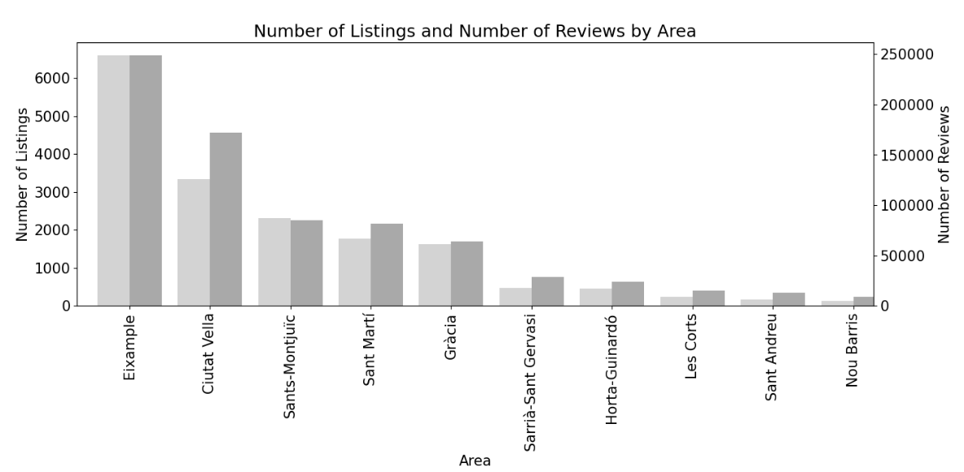

181€
85€
100€
129€
148€
120€
78€
93€
74€
65€

Slide 13
CONCLUSION
Airbnb operates in a dynamic marketplace being a very popular way to make an income both from professionals or neighbours.
There is not very a strong correlation between the most popular areas and the highest prices: quieter areas with a lower bid seems to be very desirable
Further information will be required in order to fully understand this market : apartment size, host licence, figures of the actual bookings. Also collecting data from after the pandemic and see if patterns have changed.

Slide 14
Thank you!

